Slide 1

Customer Shopping Behavior Analysis

Slide 2

Project Overview
Analyzing 3,900 purchases to optimize business decisions.
Uncover Insights
Strategic Guidance
Spending patterns, customer segments, product preferences.
Inform marketing, sales, and product development.

Slide 3

Dataset Summary
Key Features
Data Snapshot
Customer demographics
3,900 Rows, 18 Columns
Purchase details
Missing: 37 Review Ratings
Shopping behavior

Slide 4

Exploratory Data Analysis (Python)
01
Data Loading & Exploration
Imported with pandas, checked structure and statistics.
02
Data Cleaning
Imputed missing 'Review Rating' values.
03
Feature Engineering
Created 'age_group' and 'purchase_frequency_days'.
04
Database Integration
Loaded cleaned data into PostgreSQL for SQL analysis.

Slide 5
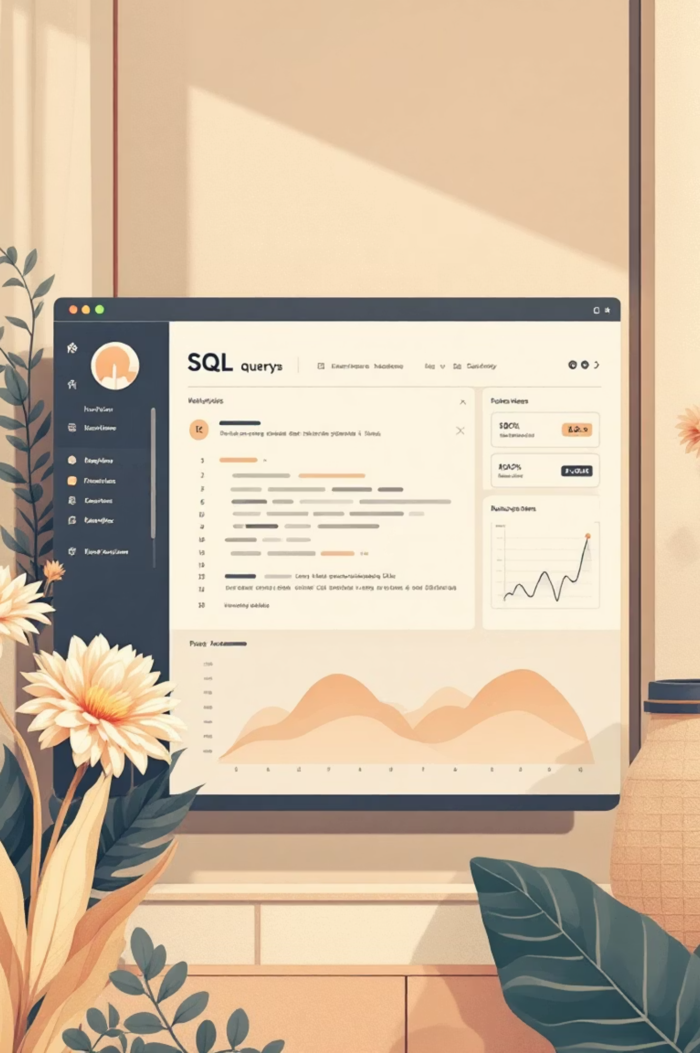
Data Analysis (SQL)
Key business questions answered through structured SQL queries.
1
Revenue by Gender
Female: $75,191, Male: $157,890
2
High-Spending Discount Users
839 customers spent above average with discounts.
3
Top 5 Products by Rating
Gloves (3.86), Sandals (3.84), Boots (3.82), Hat (3.80), Skirt (3.78).
4
Shipping Type Comparison
Standard: $58.46, Express: $60.48.

Slide 6
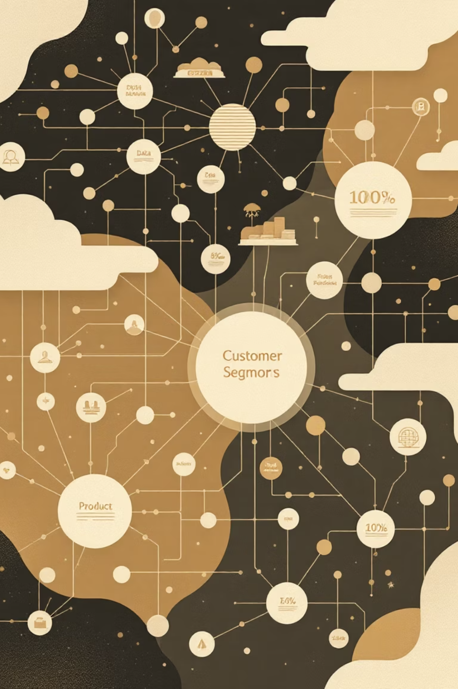
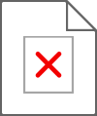
SQL Analysis: Deeper Dive
Discount-Dependent Products
Hat (50%), Sneakers (49.66%), Coat (49.07%).
Customer Segmentation
Loyal (3116), Returning (701), New (83).
Top 3 Products per Category
Jewelry, Blouse, Sandals, Jacket lead categories.
Repeat Buyers & Subscriptions
958 repeat buyers are subscribers.

Slide 7
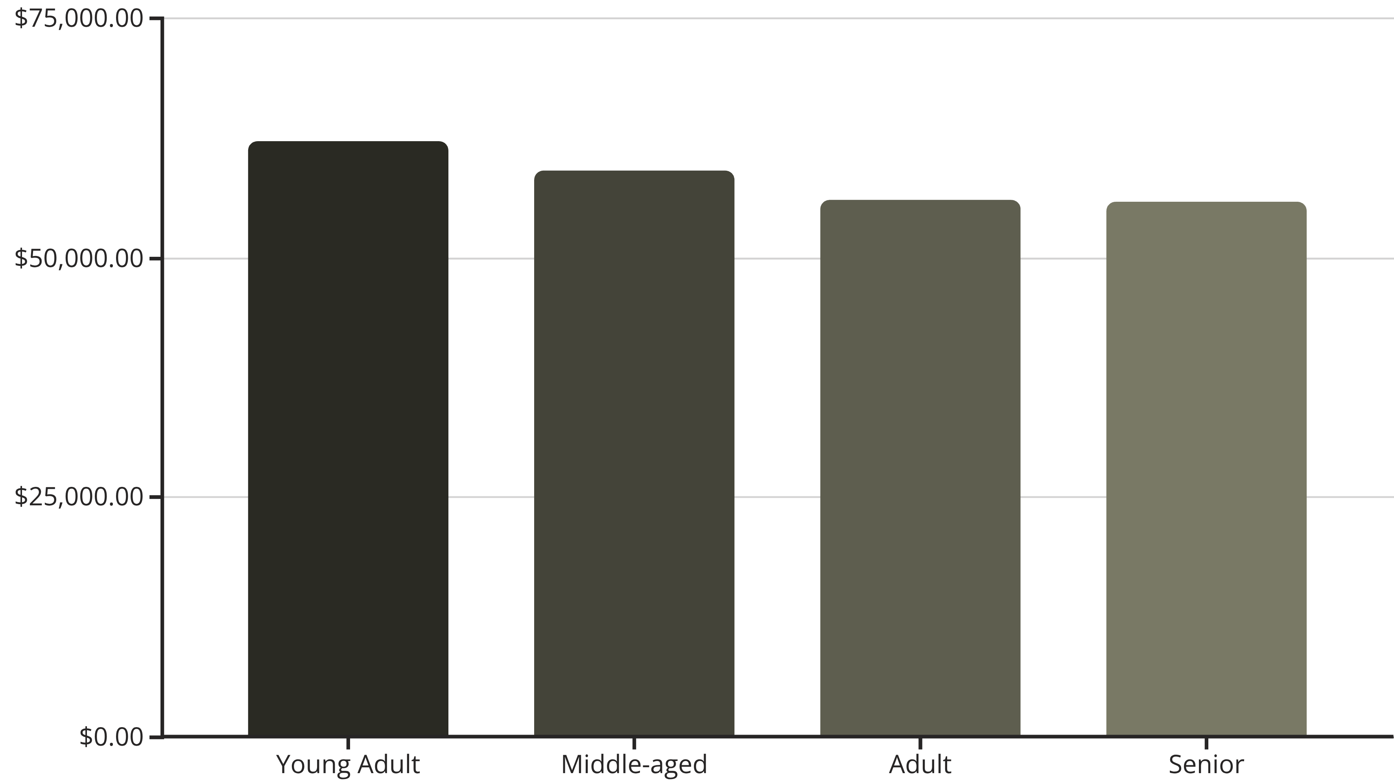
Revenue by Age Group
Understanding spending across different demographics.

Slide 8
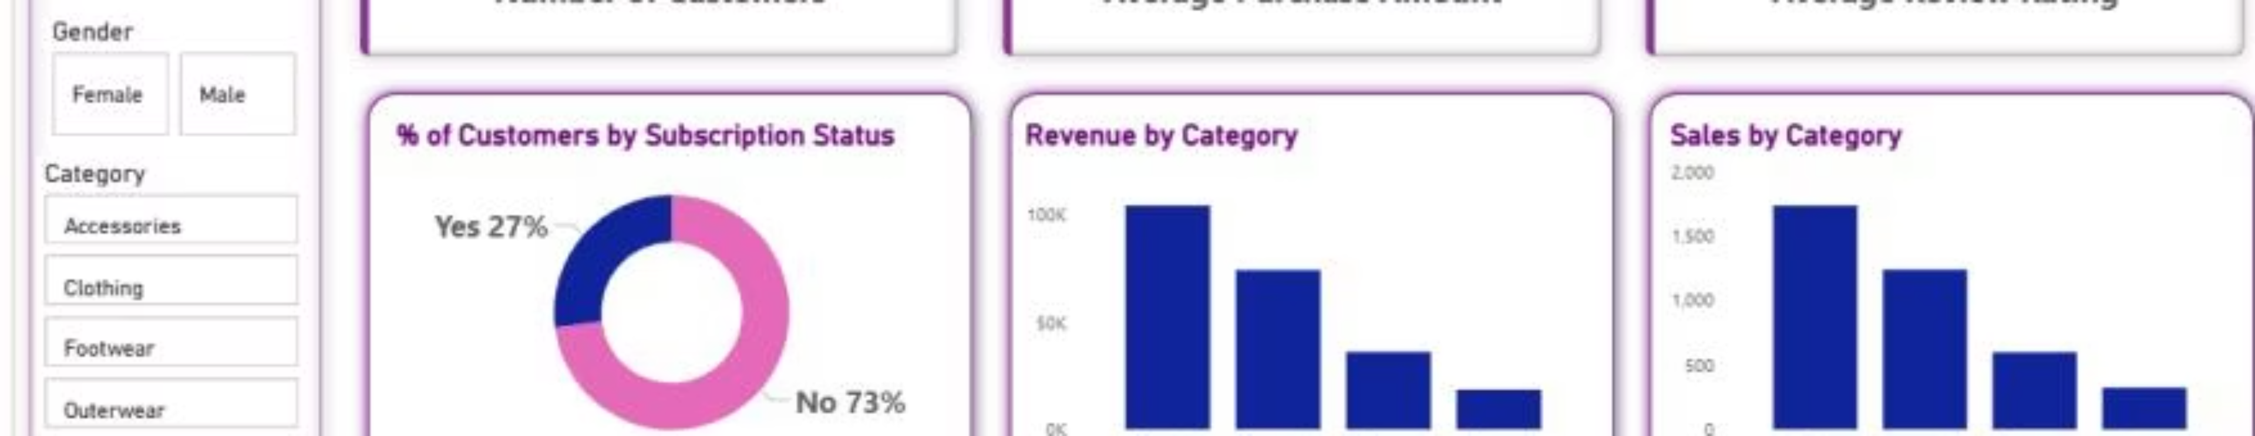
Power BI Dashboard
Interactive visualization for key insights.
Key Metrics
Visualizations
3.9K Customers
% Customers by Subscription
$59.76 Avg. Purchase
Revenue by Category & Age
3.75 Avg. Review Rating
Sales by Category & Age

Slide 9

Business Recommendations
Boost Subscriptions
Customer Loyalty Programs
Review Discount Policy
Promote exclusive benefits for subscribers.
Balance sales boosts with margin control.
Reward repeat buyers to foster loyalty.

Slide 10

Targeted Growth Strategies
Product Positioning
Targeted Marketing
Highlight top-rated and best-selling products.
Focus on high-revenue age groups and express-shipping users.

